Slide 1

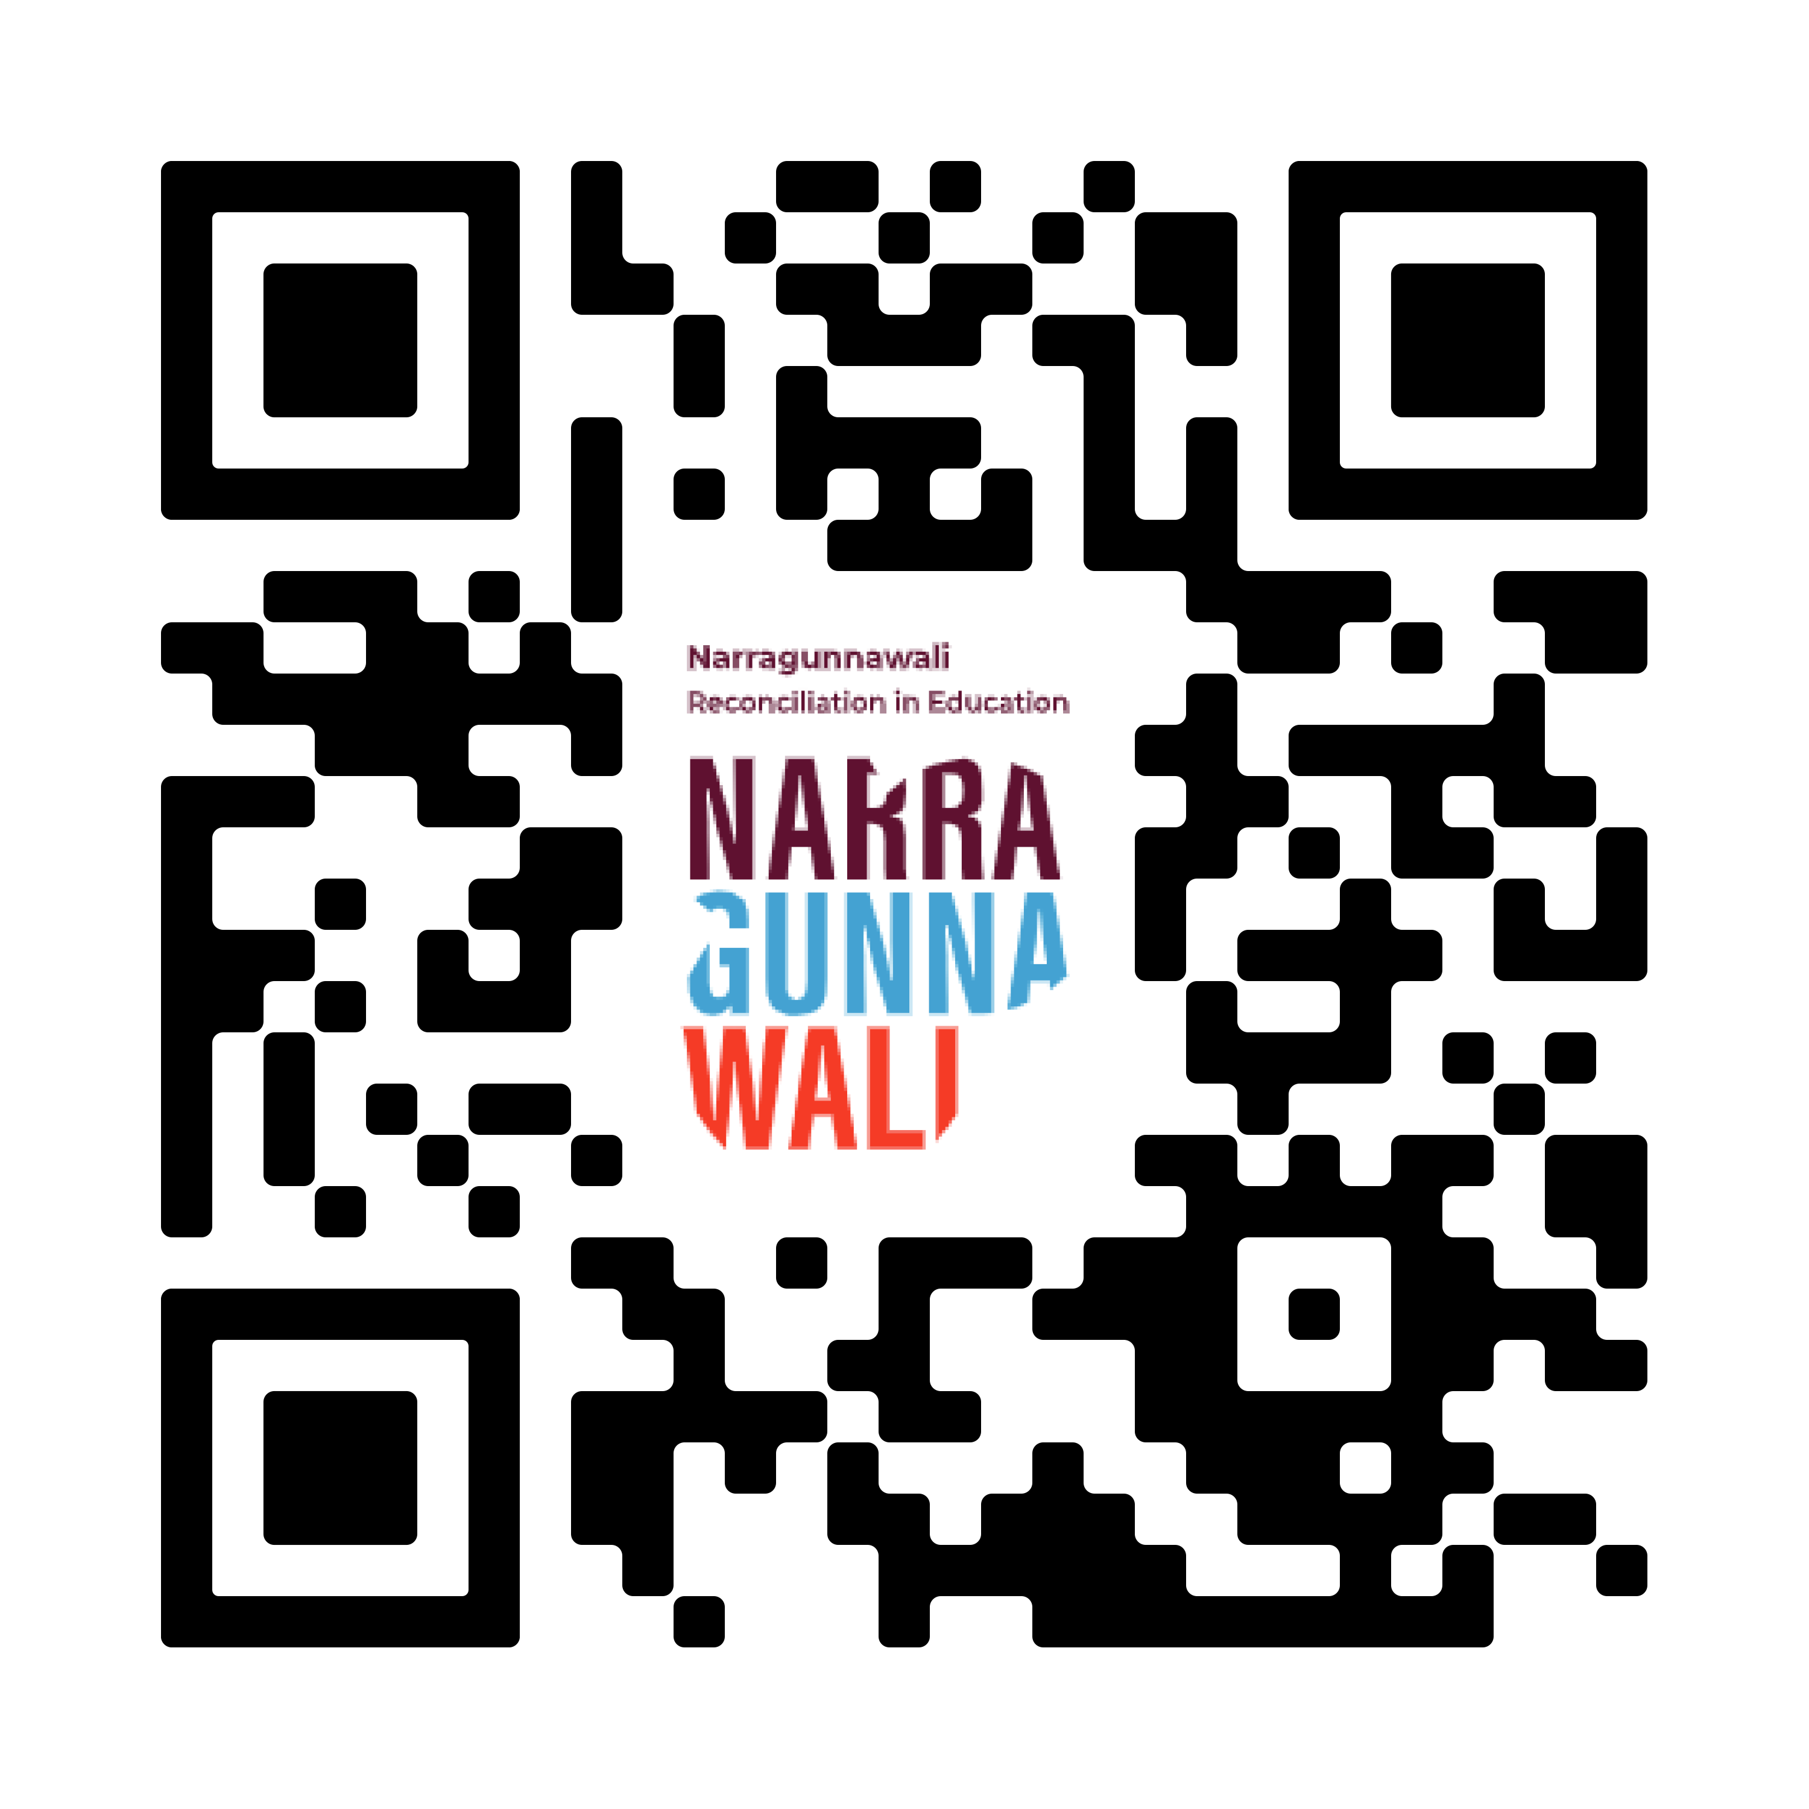

Nominations and Applications OPEN NOW!
Recognising outstanding commitment to reconciliation in education in Australian schools and early learning services.
Applications close Friday 2 May 2025
Scan QR Code for more information.
Notes:
Slide Talking Points:
Established in 2017, the Narragunnawali Awards are the only awards recognising outstanding reconciliation initiatives in Australian schools and early learning services.
there are two Categories:
Schools: Primary to senior secondary (government, independent, Catholic sectors),
Early Learning: Early childhood education, preschool, family day care, out-of-school hours care.
Nominations are open to all schools and services.
Check the Narragunnawali Awards 2025 info kit, available on the Narragunnawali Awards 2025 page for more details.
We highly encourage community members to nominate deserving schools and services.

